Slide 1
VIRTUAL MEMORY

Slide 2
VIRTUAL MEMORY
Virtual memory is a technique that allows the execution of processes that may not be completely in memory.
One major advantage of this scheme is that programs can be larger than physical memory.
This technique frees programmers from the concerns of memory-storage limitations

Slide 3
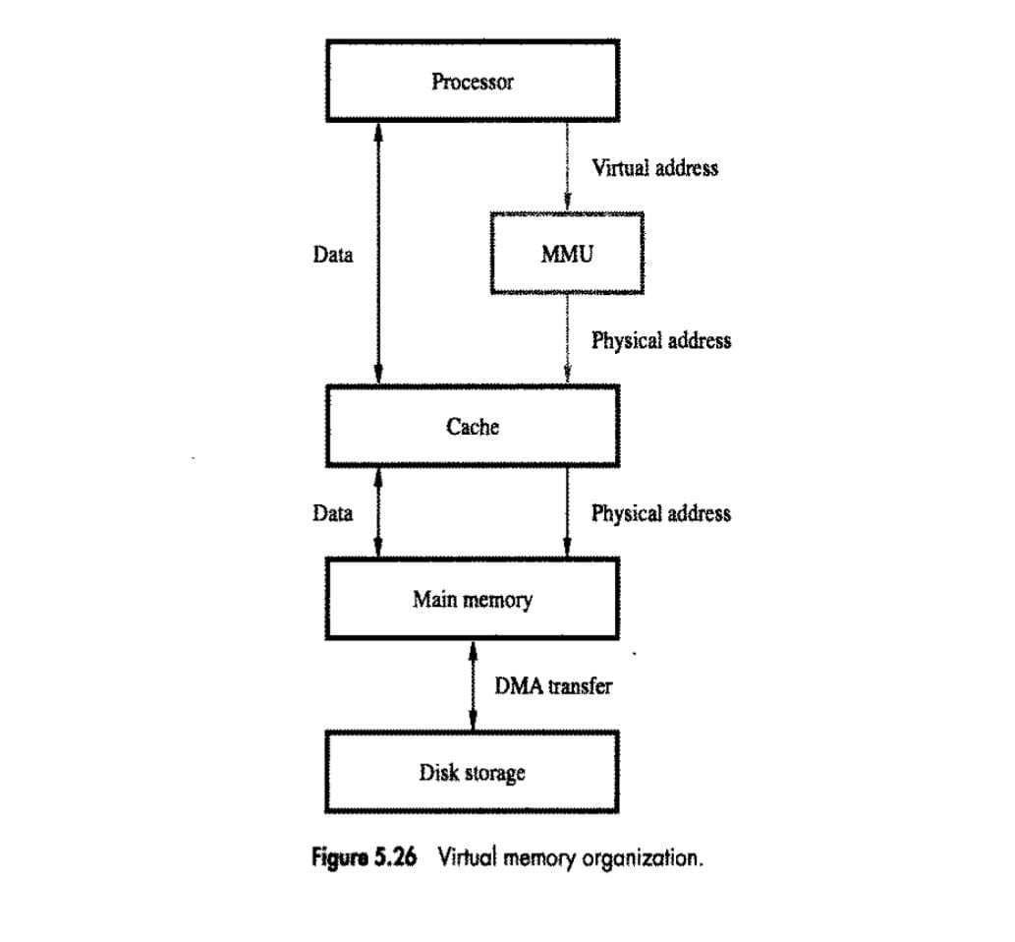

Slide 4
VIRTUAL MEMORY
The ability to execute a program that is only partially in memory would confer many benefits:
A program would no longer be constrained by the amount of physical memory that is available. Users would be able to write programs for an extremely large virtual-address space, simplifying the programming task.
Because each user program could take less physical memory, more programs could be run at the same time, with a corresponding increase in CPU utilization and throughput, but with no increase in response time or turnaround time.
Less I/O would be needed to load or swap each user program into memory, so each user program would run faster.
Virtual memory is commonly implemented by demand paging.

Slide 5
KEY COMPONENTS
Virtual Address: The address a program uses, composed of a Virtual Page Number (VPN) and a Page Offset.
Physical Address: The actual hardware address in RAM, composed of a Physical Frame Number (PFN) and the Page Offset.
Page: A fixed-size block of virtual memory (e.g., 4KB). Frame: A fixed-size block of physical memory, same size as a page.
Page Table: A data structure (per process) that maps VPNs to PFNs.
Memory Management Unit (MMU): Hardware that performs the translation.
Translation Lookaside Buffer (TLB): A cache for recent translations to speed things up.

Slide 6
TRANSALATION
Decomposition: The CPU generates a virtual address. The MMU splits it into the VPN (most significant bits) and the Page Offset (least significant bits).
Offset Stays: The Page Offset (e.g., lower 12 bits for 4KB pages) is kept as is, as the location within the page doesn't change.
Page Table Lookup: The VPN is used as an index to find an entry in the process's page table.
Frame Retrieval: The page table entry contains the Physical Frame Number (PFN).
Address Assembly: The PFN is combined with the original Page Offset to form the final physical address.
TLB Optimization: Before going to the page table (which is in main memory), the MMU checks the TLB. If found (TLB Hit), the translation is immediate.

Slide 7
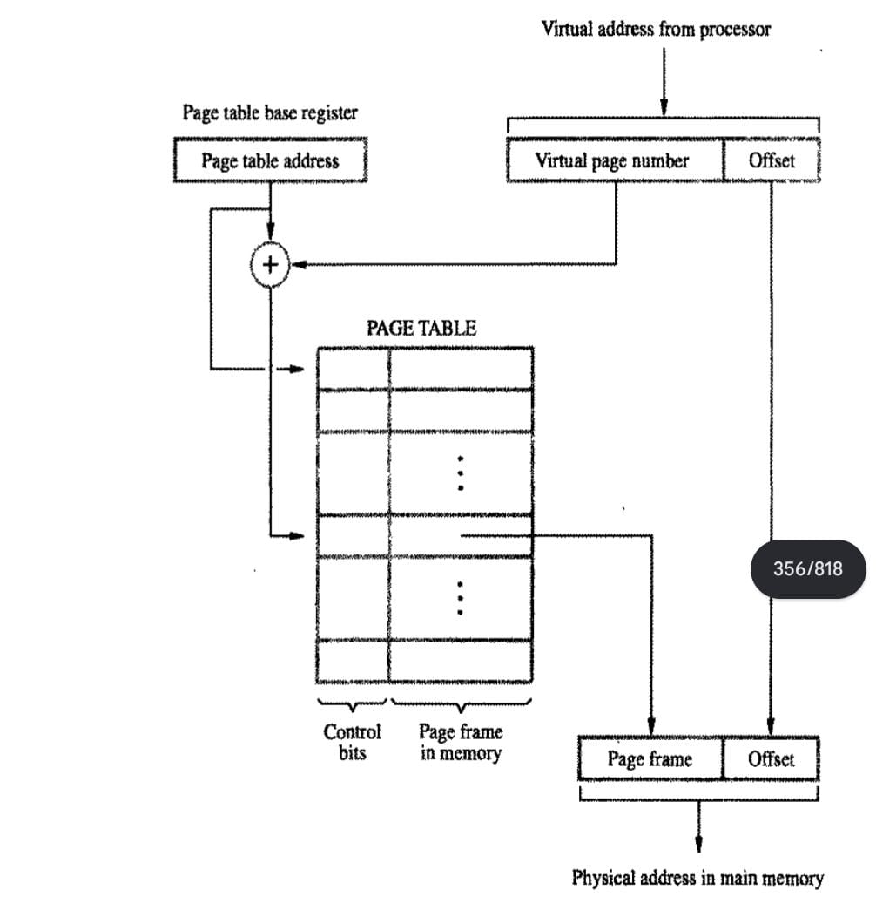

Slide 8
EXAMPLE
Virtual Address: 0xFC51908B (Hex)
Page Size: 4KB (12-bit offset)
Offset: 0x08B (the last 12 bits)
Virtual Page Number (VPN): 0xFC519 (the rest)
Lookup: Find 0xFC519 in the page table, get PFN, say 0x1A2.
Physical Address: Combine 0x1A2 (PFN) with 0x08B (Offset) to get 0x1A208B.

